Slide 1



CARE for the Poor
Transform your Compassion into Action

Slide 2



Slide 3
PeaceBox 2024 Timeline
Mission
Sharing & Promotion
PeaceBox Gift Delivery
Giving out PeaceBox gifts
Promotion & Gift Collection
December 2023
– January 2024
February
2024
March
2024
March-April
2024

Slide 4
250,000
10 years

Slide 5
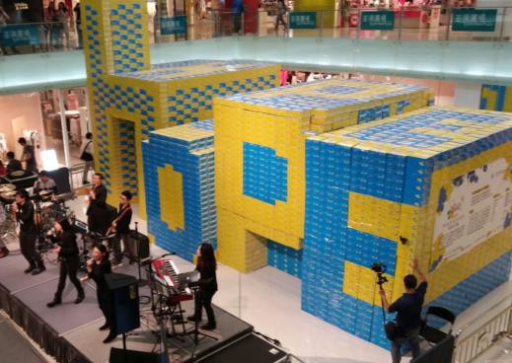
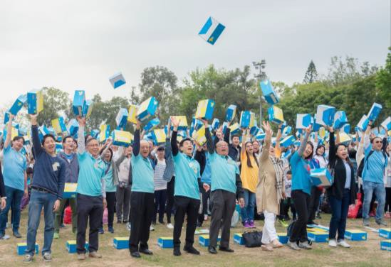
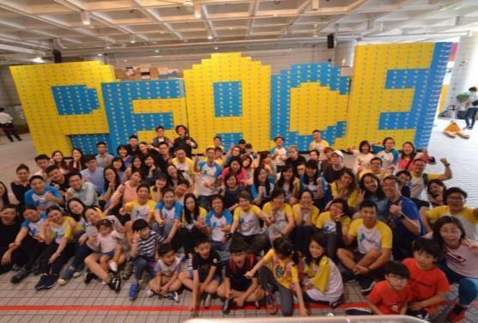
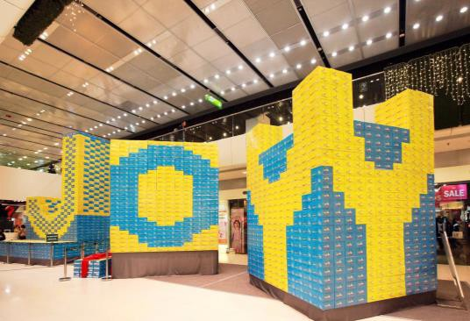
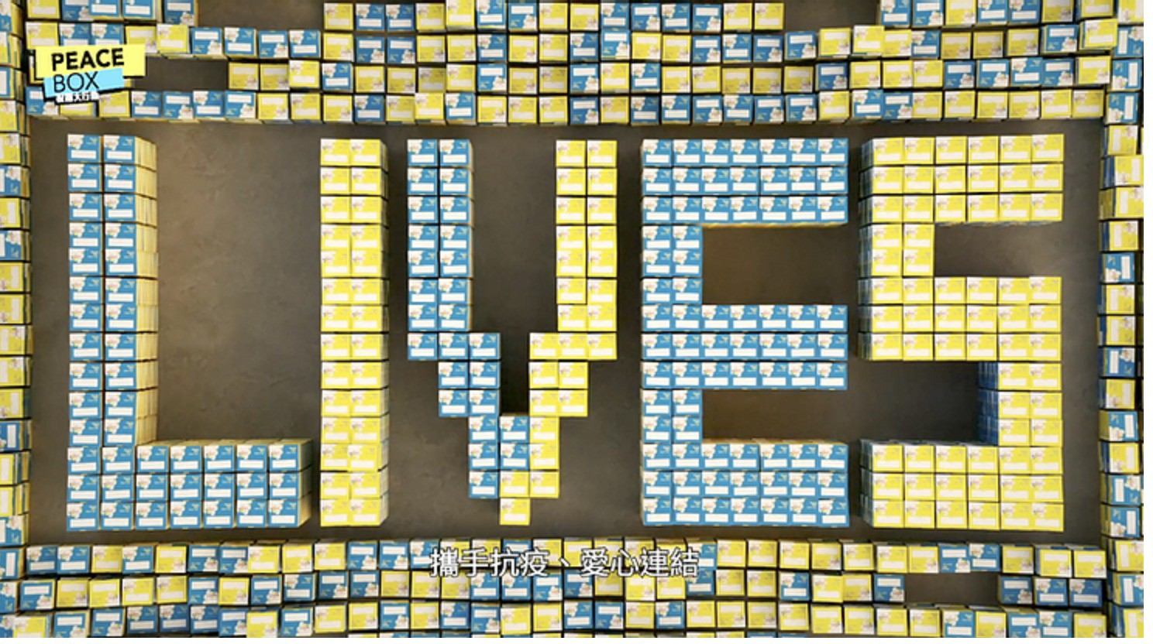
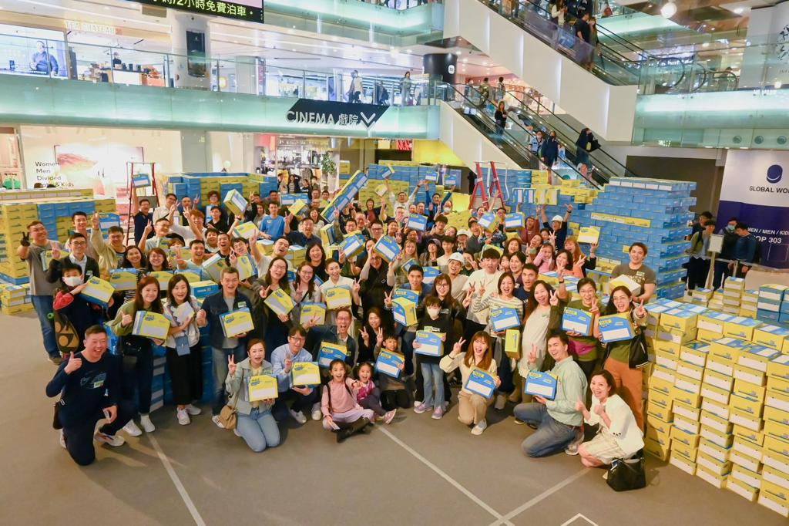

ANNUAL EASTER CELEBRATION CAMPAIGN
2017 HOPE
2018 LOVE
2019 PEACE
2020 HOPE
2021 LIVES
2022 DREAM
2023 GROW
2024 Light
Dream

Slide 6
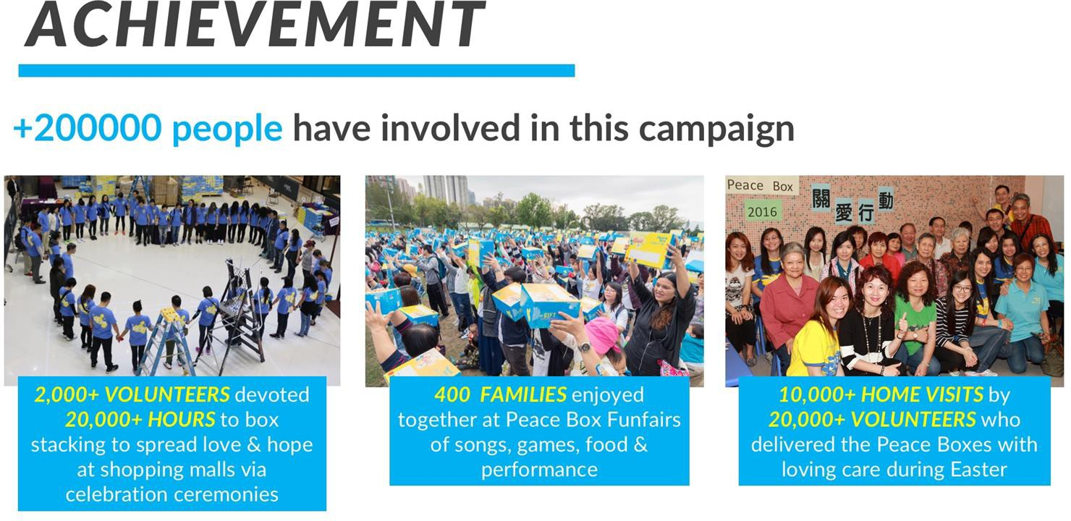
250,000

Slide 7
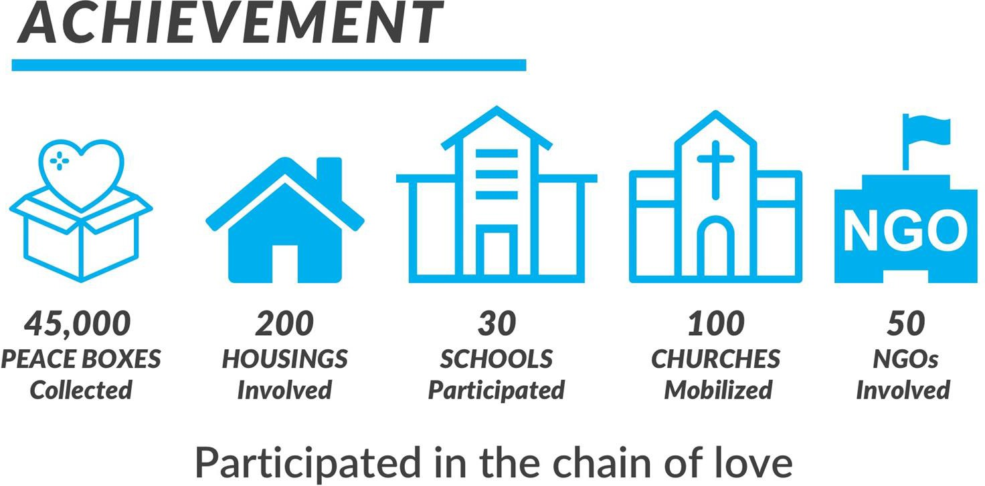
100,000

Slide 8
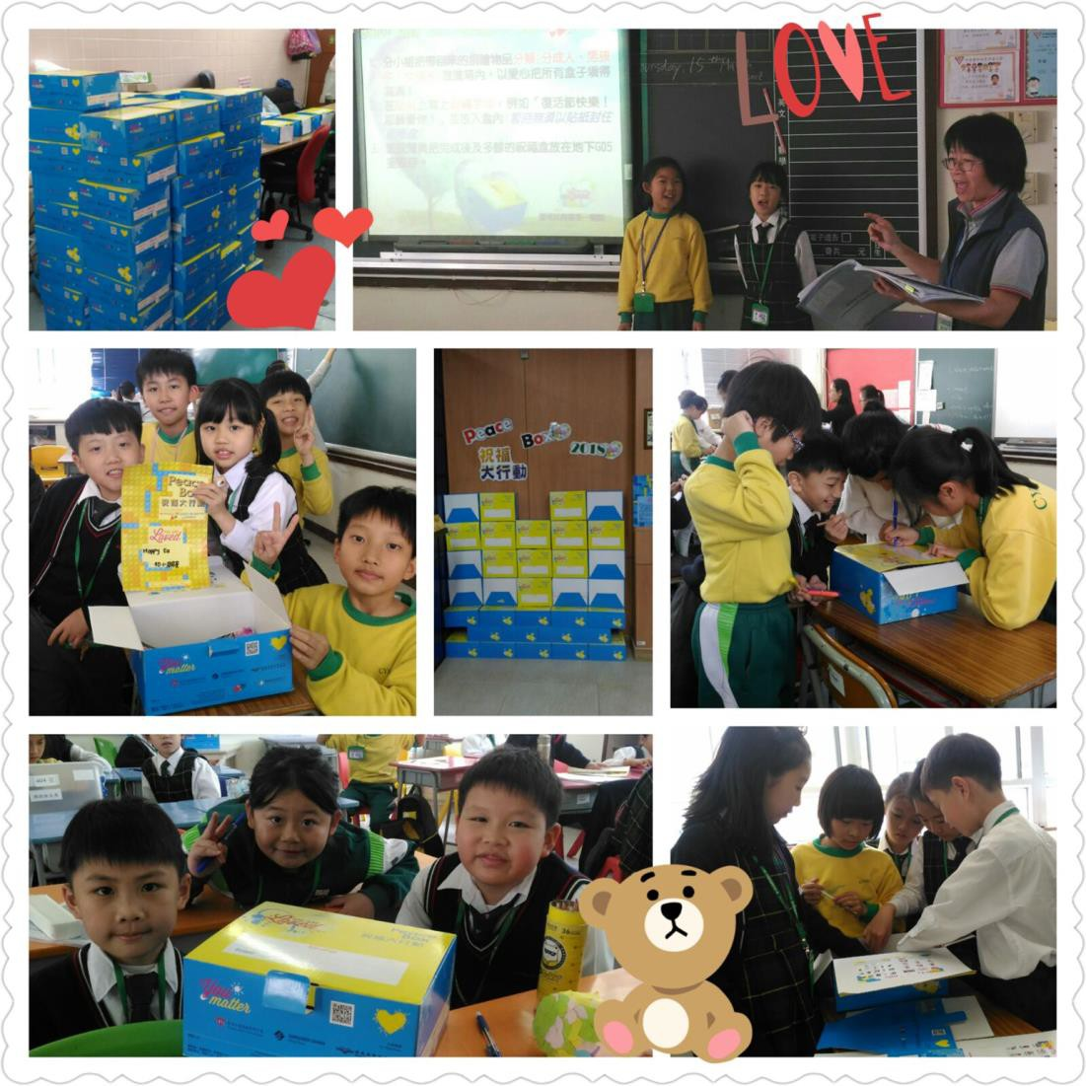
PeaceBox Donation

Slide 9


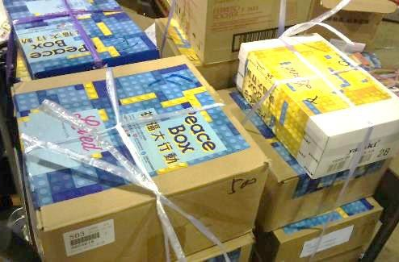
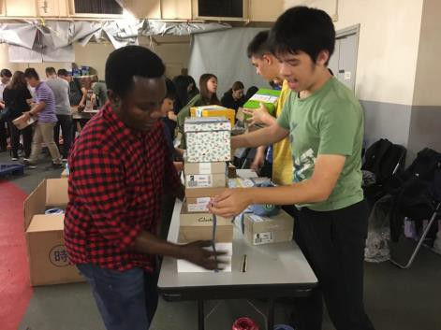
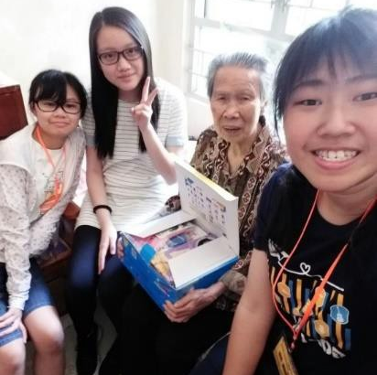
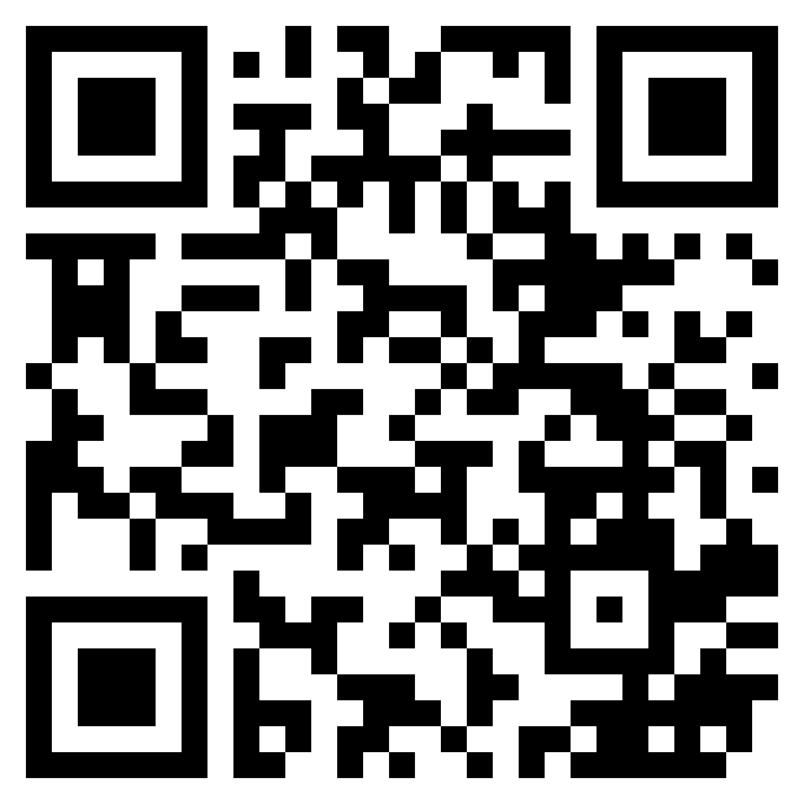
Join us:
Collect & Distribute PeaceBox
Ways of Participation
You can participate in any one or more ways
Gift Collection
Check
Distribute with
blessing card
Online Donation:
Visit https://www.hkcnp-loveinaction.org.hk/
to purchase PeaceBox supplies.
The conference will distribute them to the grassroots community through the church and NGO network.
The little gifts will become blessings for the poor throughout the campaign!
Donation
through

Slide 10
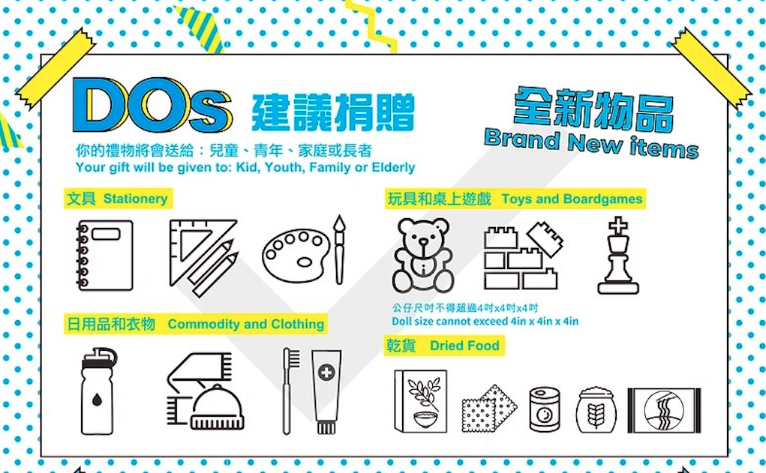
What kind of supplies is suitable for donation to the underprivileged community?
Yes
Every donating items to PeaceBox must be NEW, therefore, any used or second- hand products are not suitable for donation.

Slide 11
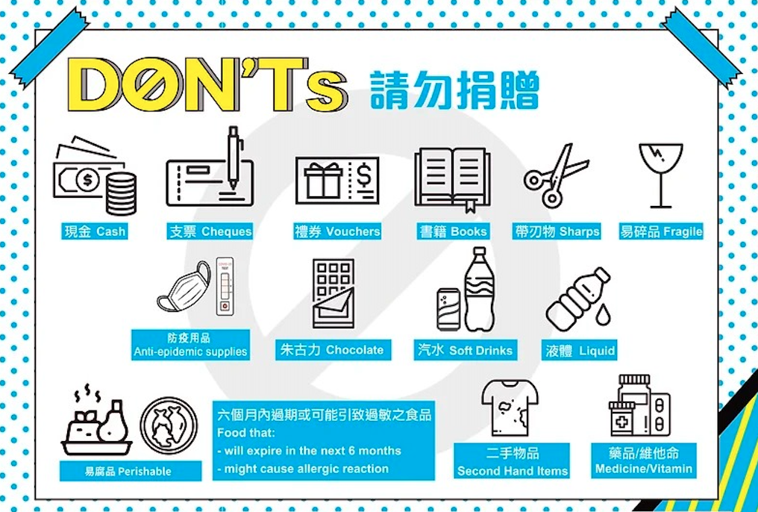
What kind of supplies is suitable for donation to the underprivileged community?
NO
Every donating items to PeaceBox must be NEW, therefore, any used or second- hand products are not suitable for donation.

Slide 12
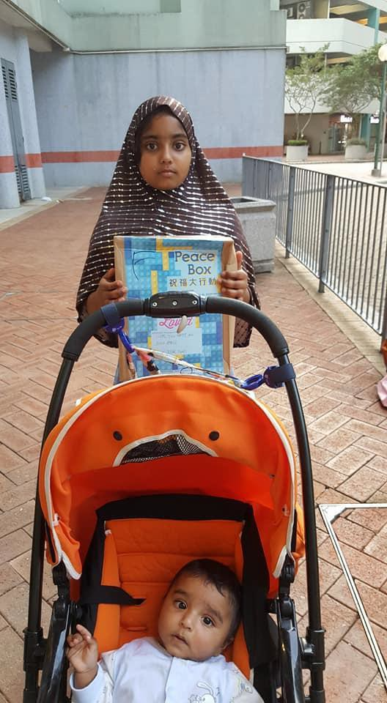
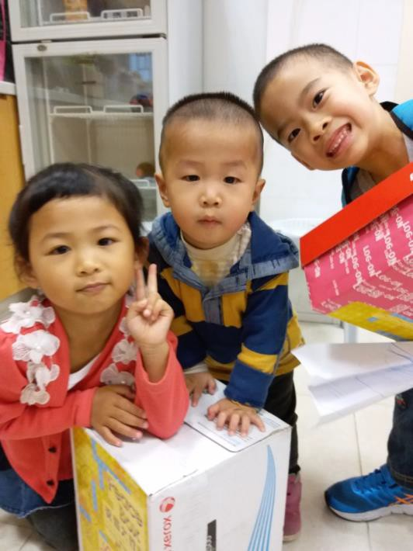
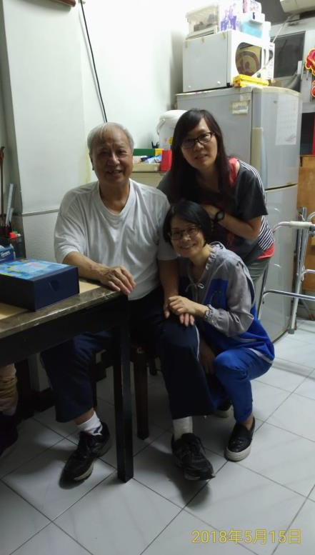
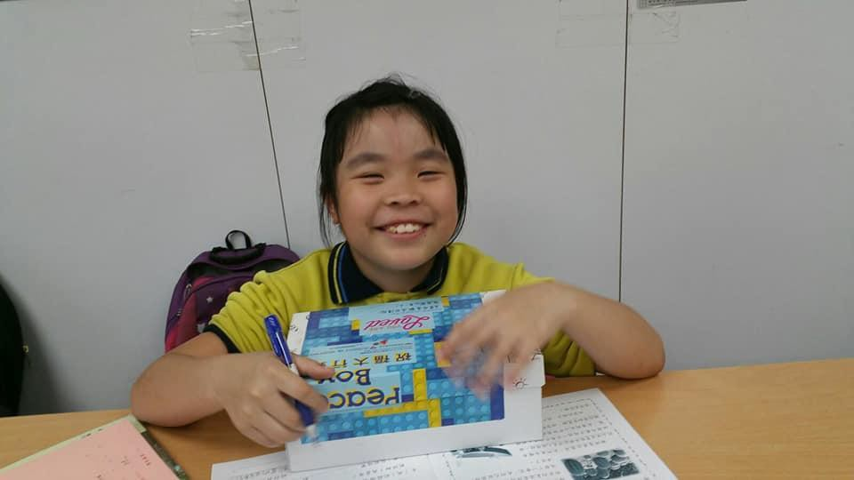
PeaceBox beneficiaries

Slide 13
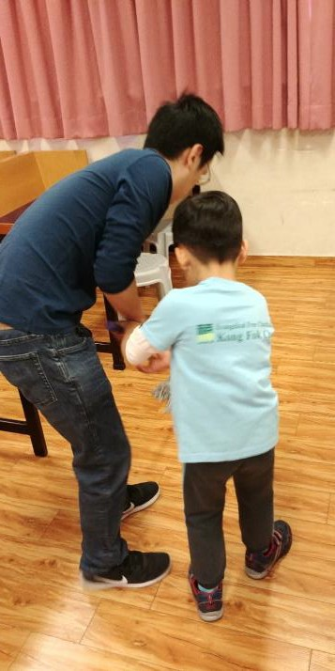
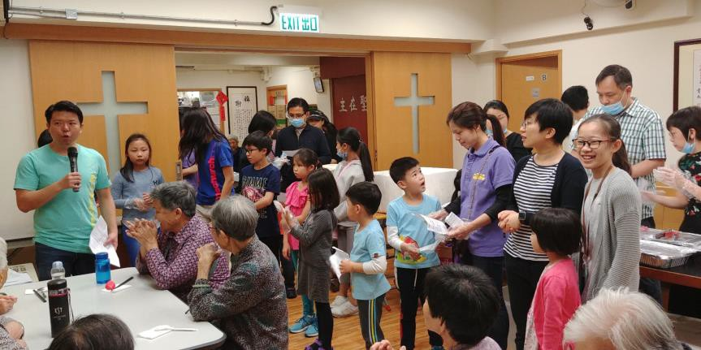
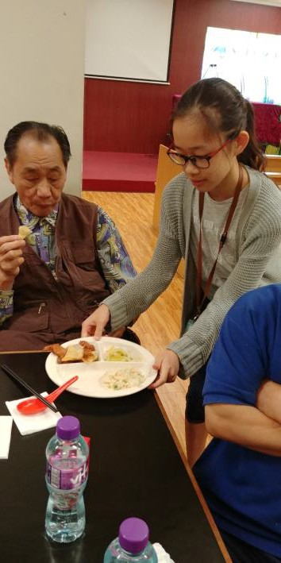
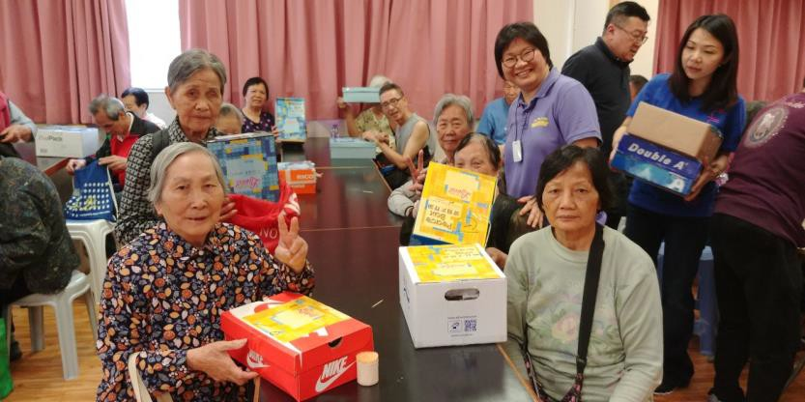

Family Service

Slide 14
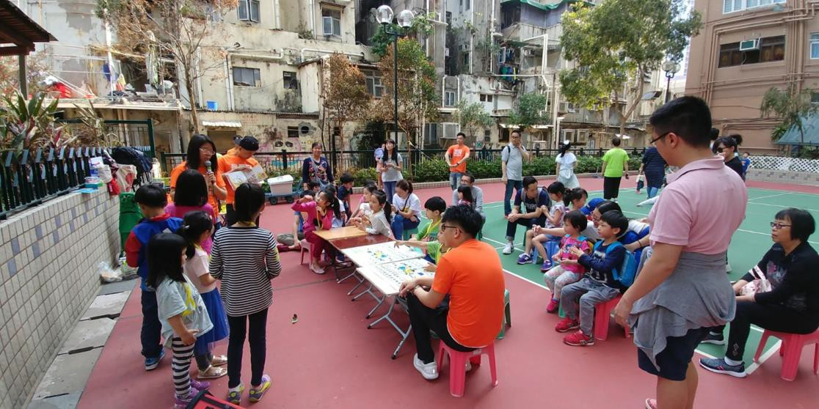
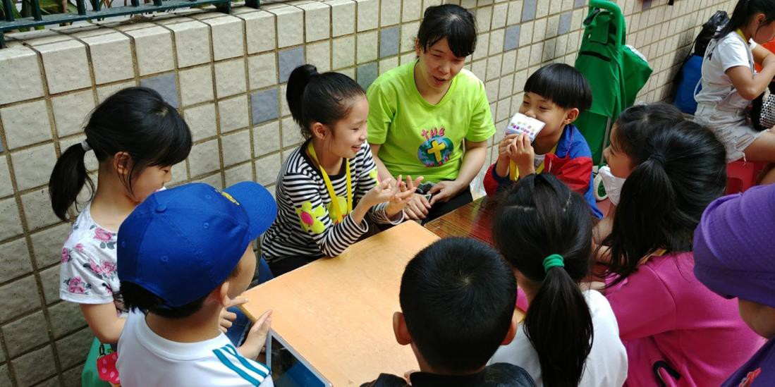
Serving in the Park

Slide 15
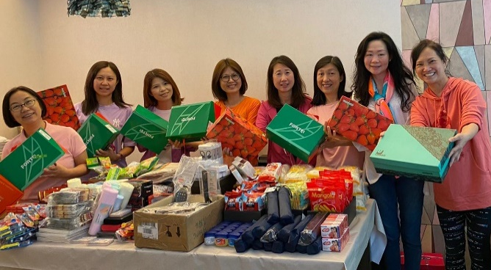
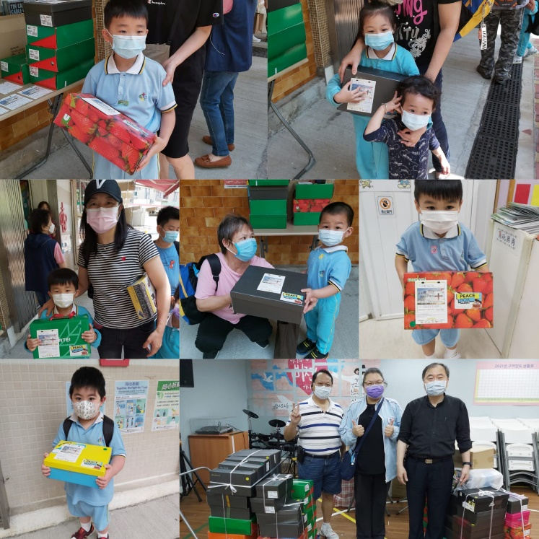
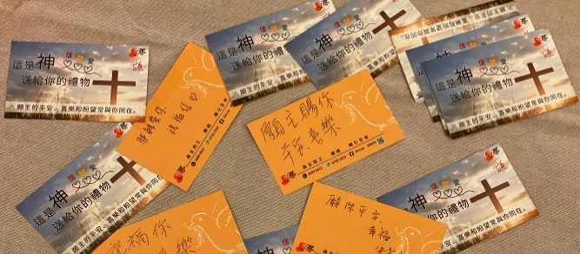
Church Fellowship and
Cell Groups
Fellowship and Cell Groups
Can also join, in serving the community, to share the love of God.

Slide 16
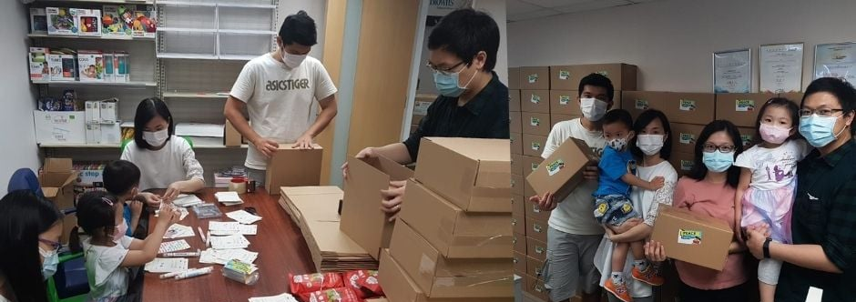
Corporate Social Responsibility

Slide 17
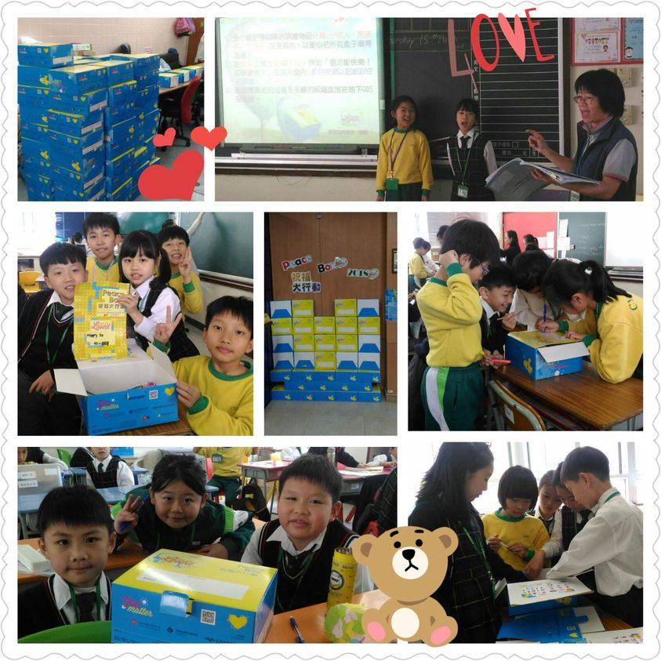
Encourage students to participate, and teach them to share and care for the needy
Students can Participate

Slide 18

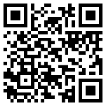

More about HKCNP
PeaceBox
https://www.hkcnp.org.hk/core_services/love_in_action/peacebox_2024_english_version/
Support by donation:
https://www.hkcnp-loveinaction.org.hk/
The Hong Kong Church Network for the Poor (HKCNP) Website
http://www.hkcnp.org.hk/
Facebook
https://www.facebook.com/hkcnp/

Slide 19







Organizers

